Slide 1

School of Computer Science & IT
Programme: BCA
RESEARCH METHODOLOGY(22BCA5RM01)
MODULE 1: Introduction to Research

Slide 2
Session -5
Necessity of Defining the problem
Technique involved in defining the problem

Slide 3
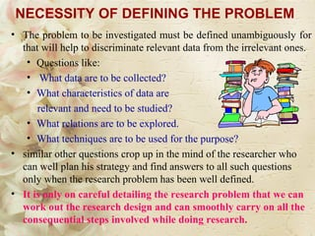
Necessity of Defining the problem

Slide 4
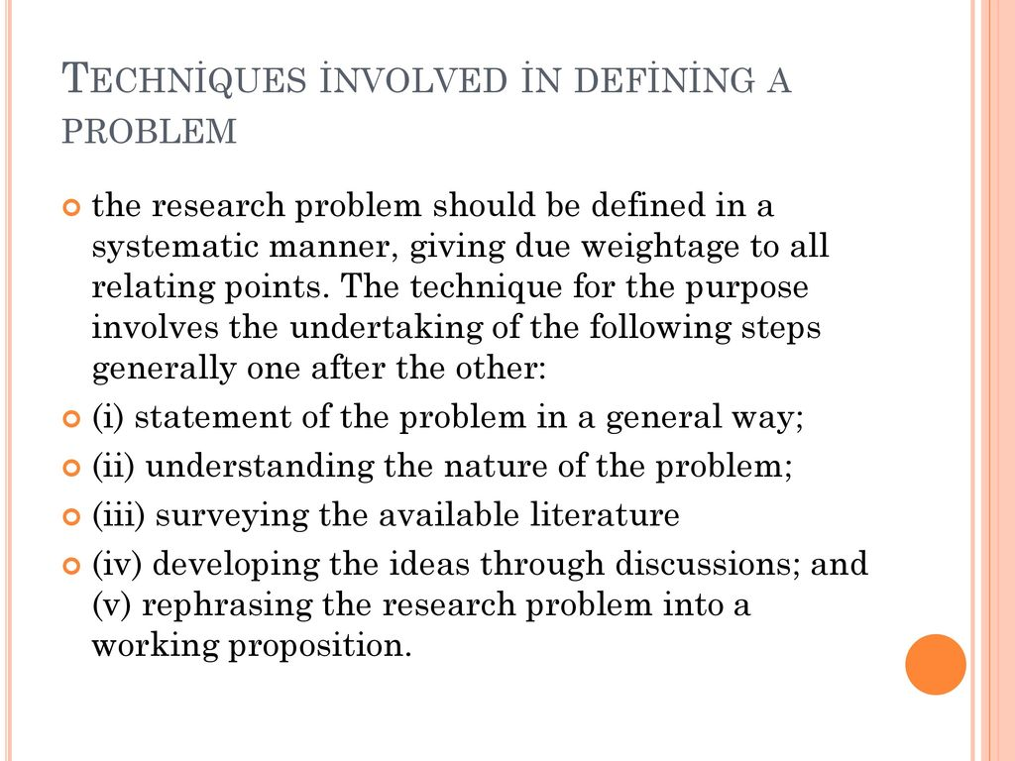

Slide 5
Narrowing Down Frameworks
Several frameworks and approaches can help to narrow down a research problem.
. PICO
The PICO framework is often used in healthcare and medical research to formulate focused research questions. It involves identifying the specific population or patient group, the intervention or treatment being considered, the comparison group or alternative intervention, and the desired outcome.

Slide 6
FINER
The FINER technique is a tool that researchers should consider when evaluating and refining their research questions:
• Feasible: A research question should be feasible, considering available resources, time constraints, and access to data or participants
• Interesting: An interesting research question captures the researcher’s and the wider academic community’s attention and curiosity
• Novel: A research question should exhibit novelty by exploring new perspectives, approaches, or methodologies
• Ethical: Ethics play a critical role in research, and a research question should align with ethical considerations and guidelines. Researchers must ensure their study prioritizes participants’ well-being, privacy, and rights
• Relevant: Relevance is an essential criterion for a research question, ensuring that the study addresses real-world problems or contributes to advancements in theory or practice
Researchers can critically evaluate and refine their research questions using the FINER technique to ensure feasibility, interestingness, novelty, ethical integrity, and relevance. This evaluation process enhances the quality and impact of the research, leading to more focused and purposeful studies:

Slide 8
SPICE
The SPICE framework is commonly used in social sciences and qualitative research. It helps researchers narrow down the research problem by considering specific elements. Setting refers to the context or environment of the research. Perspective involves identifying the viewpoints or perspectives of the individuals involved. Intervention refers to the actions or changes being studied. Comparison is the alternative or control group, and evaluation refers to the desired outcome or impact.
The framework guides users through five components:
• Setting – where?
• Perspective – for whom?
• Intervention – what?
• Comparison – compared with what?
• Evaluation – with what result?
Although this technique is mainly used for social sciences, to some extent, it can be applied to any field:

Slide 10
Gap Analysis
This framework requires a thorough review of the existing literature and identifying gaps or knowledge deficits in the field. By critically analyzing previous studies and identifying areas that haven’t been adequately addressed or require further exploration, researchers can narrow down the research problem and focus on addressing these gaps. Gap analysis helps ensure the research problem is relevant and contributes to the existing body of knowledge.
Using gap analysis tables might provide structure to this approach:
It’s possible to get a hint about a research gap and the direction from the recommendations for future research sections in available research.

Slide 11
The problem solution framework

Slide 12
The Context-Action-Result (CAR) Framework

